Slide 1

Have Your Website
Bring You New Business
Sandy Huang
Lesslie Hernandez
SunNet Solutions
www.SunNet.us

Slide 2



Slide 3
7 critical points for your website
Is it mobile friendly?
Modern or dated look?
Latest technology (ex. browsers, mobile phones)?
Your website vs your competitor’s site?
Many visitors on your site?
Is your site promoting steady business growth?
Any compliments on your site?

Slide 4
4 important things to consider if redesigning
Mobile-friendly
The right graphic design and layout
The right content
Search Engine Optimization (SEO)
Notes:
Benefit: Customers can quickly learn about your business via their phone.
Benefit: Provides a professional company image.
Benefit: Credibility, reliability, attractive, informative
Bring new business from internet searches

Slide 5

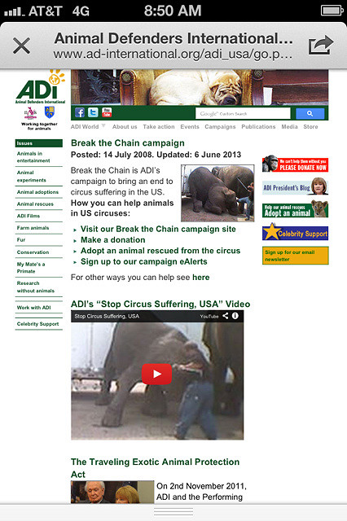
Make your site mobile-friendly
Responsive website
Mobile Web
Mobile app
Display your content in an
organized manner across
all platforms

Slide 6

User-friendly navigation bar
  Quick access to information
  Easy to browse
  Increase time visitors stay on site
  Make it extremely easy for visitors to contact you
Notes:
Quick access to information
Easy to browse
Increase visitor stay on site
Make it extremely easy for visitors to contact you

Slide 7
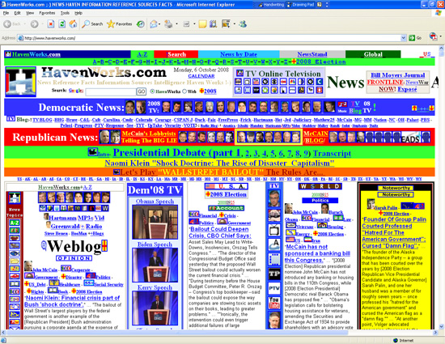
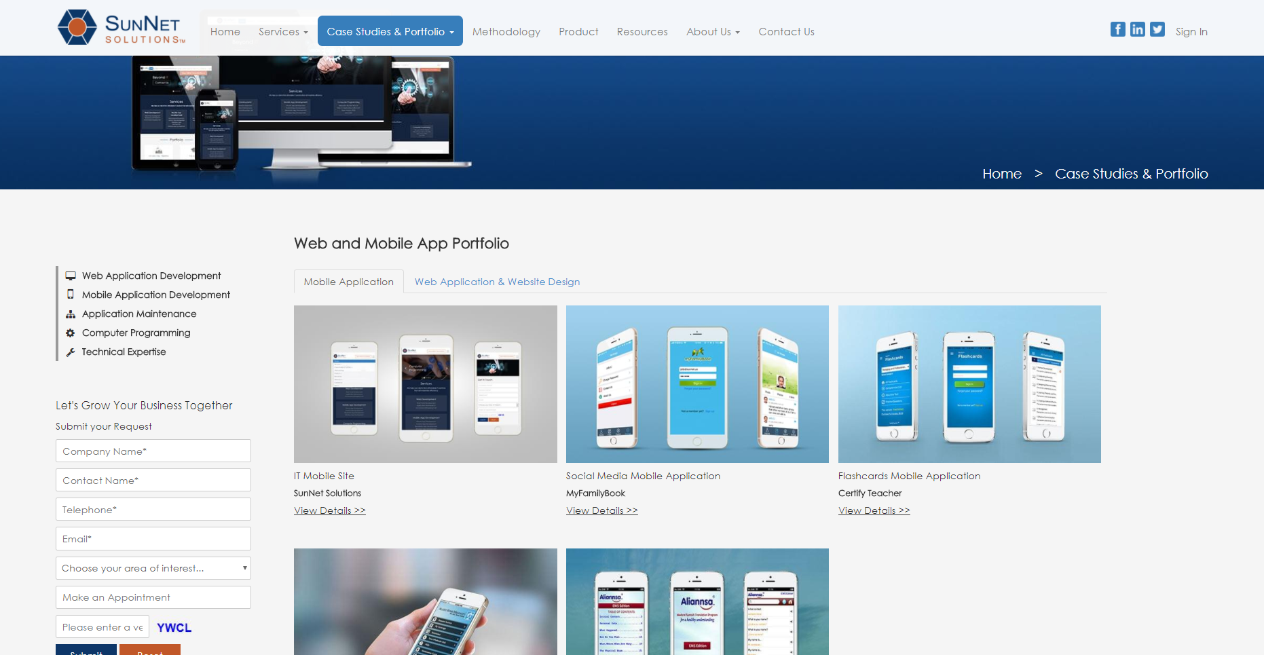
Keep design simple
Notes:
Too many colors and too many images may distract your visitors and do not know where to focus their attention
Have good contrast of text and background

Slide 8
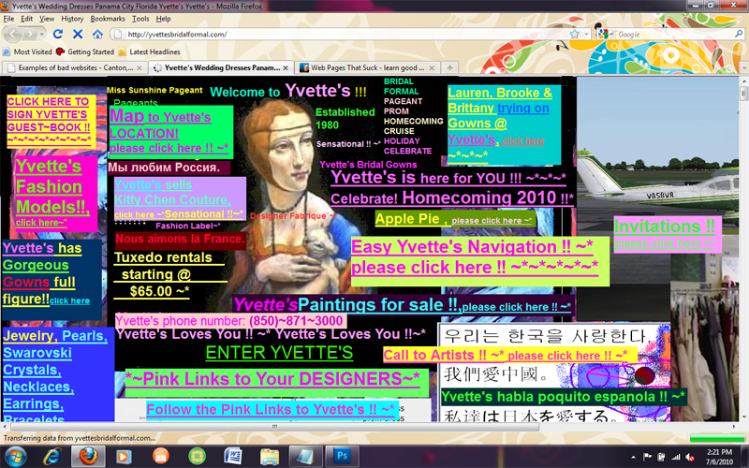
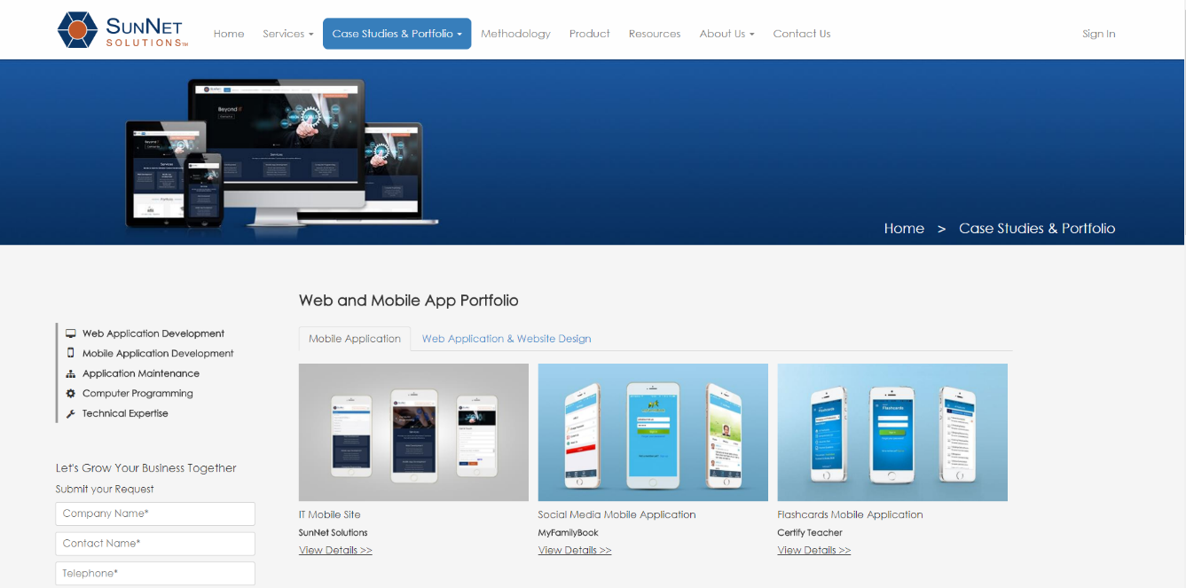
Give layout enough spacing
Notes:
Not giving your layouts enough spacing can make your site look to busy and crowded.
Make your site as appealing to the eye as possible.

Slide 9
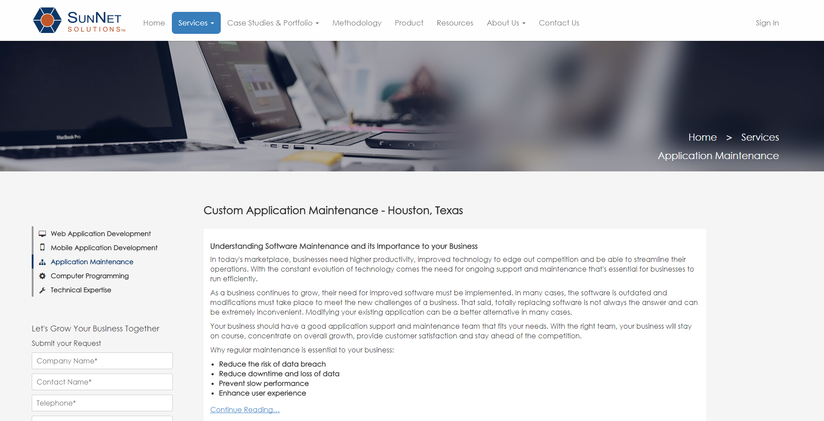
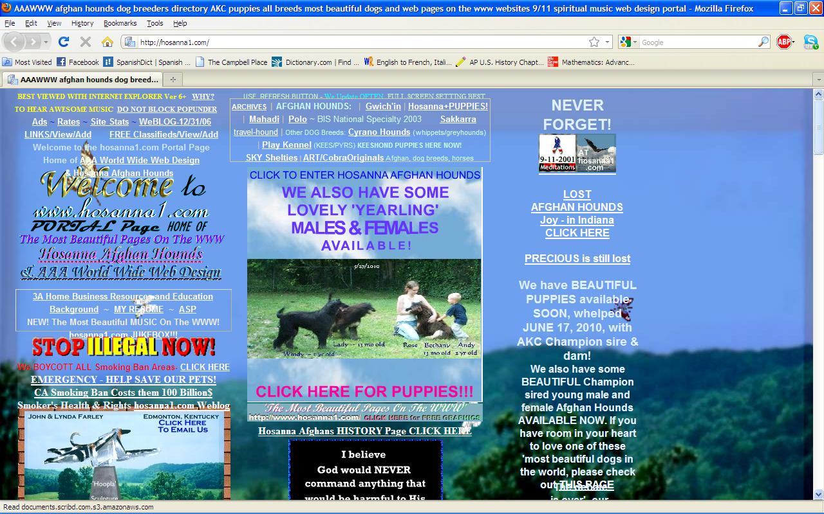
Make content easy to read
Notes:
If content is easy to read, your audience will enjoy reading and spend more time on your website learning more about your business and capability.
Select the right font, size, and spacing between the lines.

Slide 10
Keep content fresh
Outdated information can hurt your credibility
Search engines also like fresh content

Slide 11
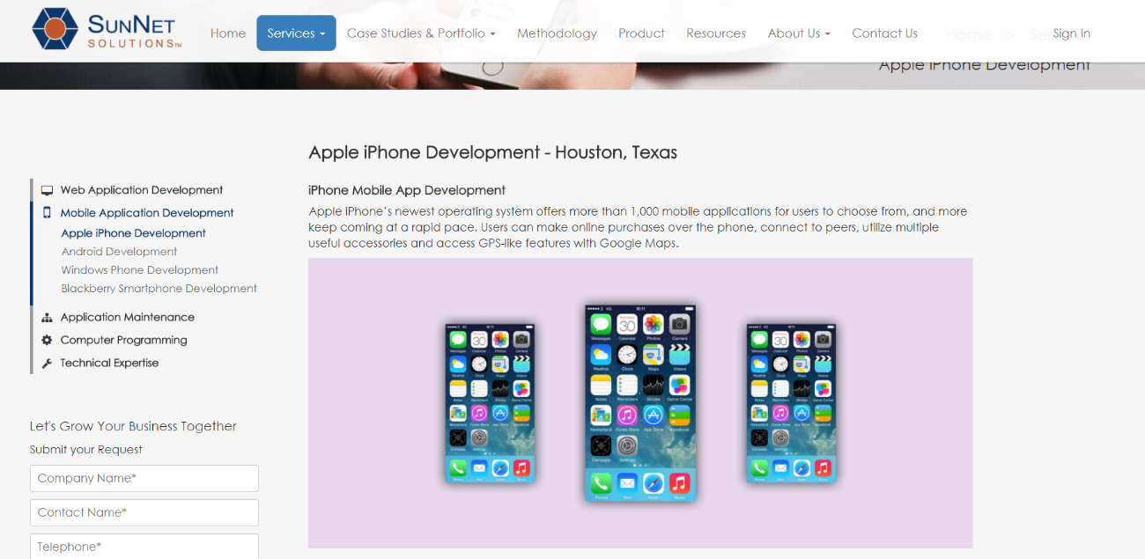
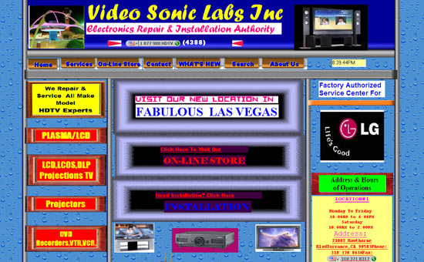
Create interest, add pictures
Notes:
Add pictures to break up text and create interest
Too much text may tire your visitor and prompt them to leave your site
Avoid cheap images
Use attractive, eye-catching images that complement your content

Slide 12
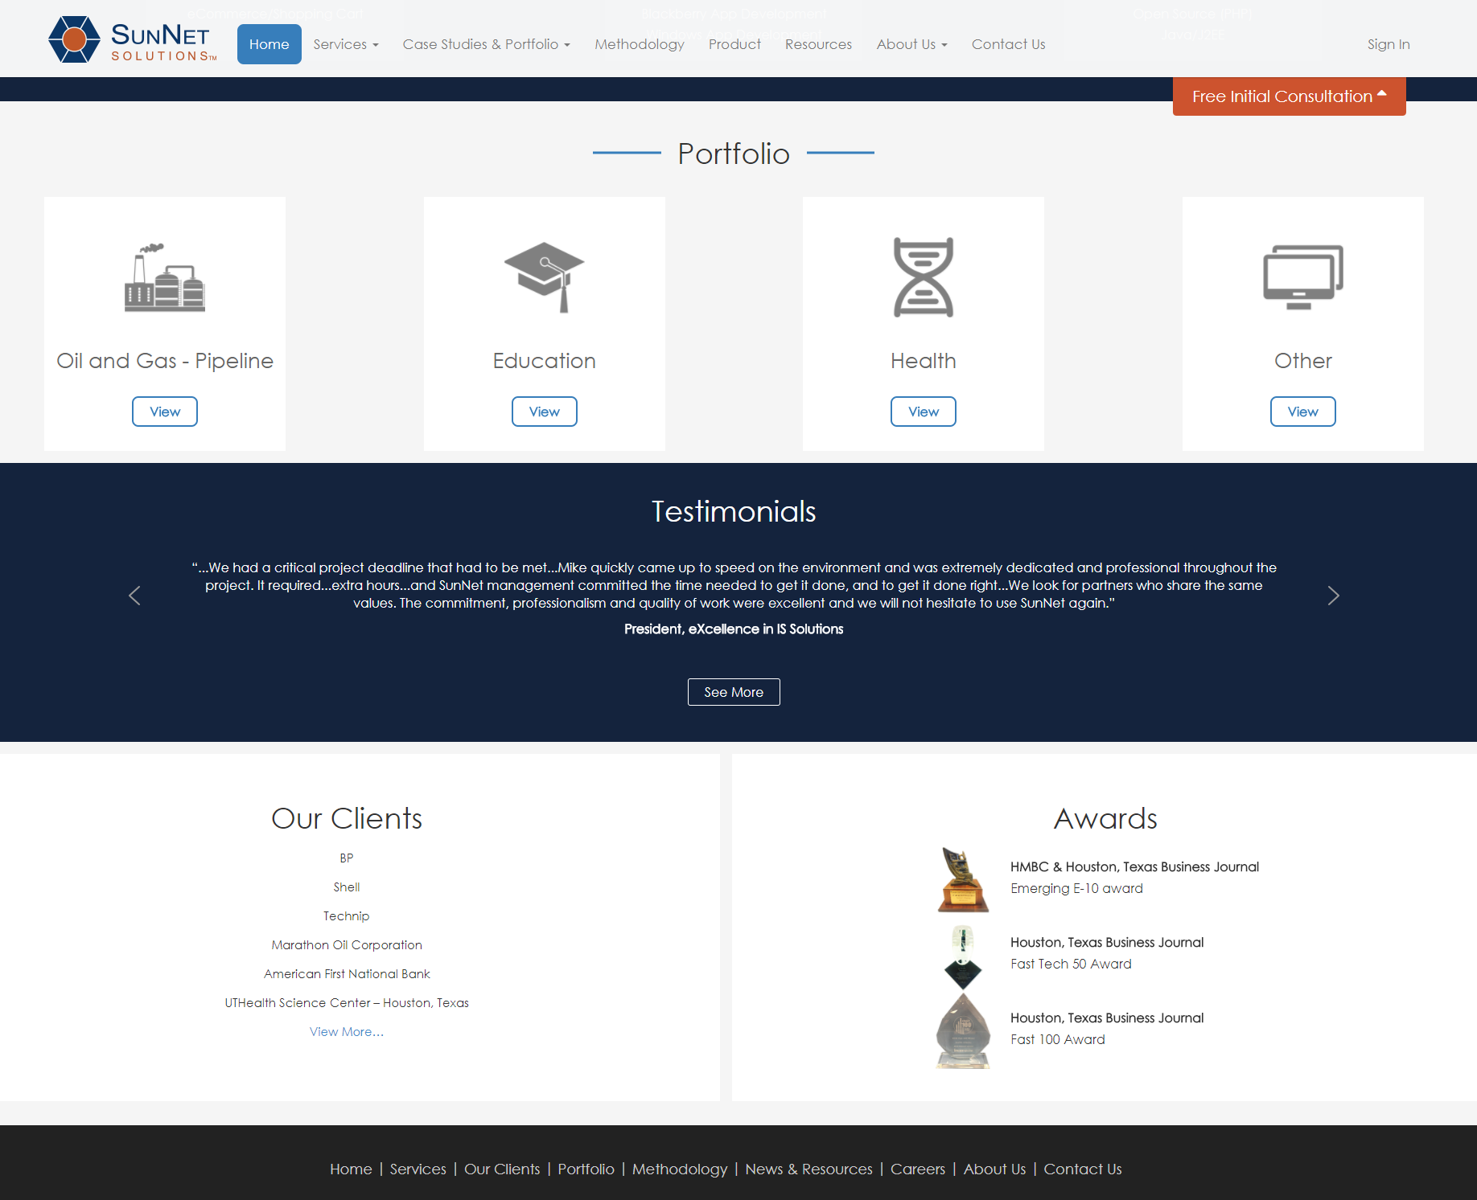
Add credibility
  Customer testimonials
  Portfolio
  Awards
  Certifications
  Clients etc.

Slide 13
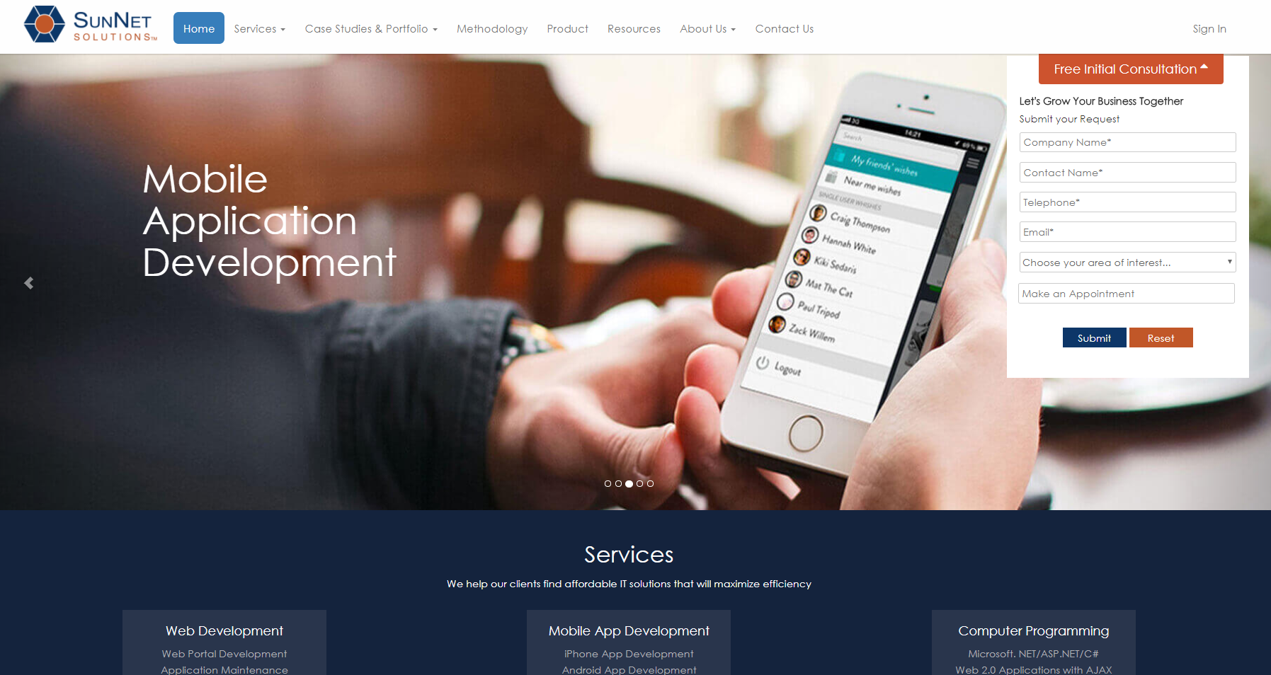
Contact us section
Easily visible to your visitors
A quick link on the home page is an good option
Catch some important information
Automate appointment
set up if applicable

Slide 14
SEO in your website coding
Simple things to start with are:
  Meta description: summarizes your page’s content
  Meta keywords: tell search engines the page topic
  Title Tag: specifies the page title and is displayed on the
  search engine results page
  H1/H2 Tags: contain targeted keywords that are closely related to the
  title and hour content

Slide 15
SEO in your URL design
  Must contain that page’s top keyword
    Don’t use too many keywords to the
    point your site looks “spammy”
  If multiple words, use hyphens to separate, not underscore
  Do not make your URL too long
  Make it attractive to your visitors, make sure they have an idea of what your page is about by looking at the link

Slide 16
SEO credit from old website’s URLs
If you already have existing URL’s and
are thinking about changing them, use a 301 redirect
        Cause a split of ranking signals
        Hurt your search traffic

Slide 17
Interested in scanning your site
for a performance report?
Visit: https://sunnet.us/technical-tips-houston-texas-tx

Slide 18
Last thing: Promote your website
Use social media!

Slide 19
Lesslie Hernandez
SunNet Solutions
Tel: 713-783-8886
Email: NewProject@SunNet.us
www.SunNet.us

